Slide 1
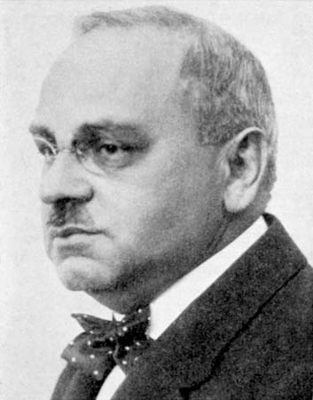
Perspectives On What It Means To Be An Adlerian In The 21st Century
Lori Ann Wagner
Marina Bluvshtein
“We now leave rightly the ground of absolute certitude, on which so many psychologists bustle about.” – Alfred Adler

Slide 2
An Adlerian Identity Crisis
Why do we keep coming back to the same question?
Fear of Change?
Fear of Success?
Fear of Failure?
….?
What’s the purpose of asking the same question again & again?

Slide 3
An Adlerian Identity Crisis
Am I An Adlerian?
Dreikurs (1972), Mosak (2003), Bitter (2007)
Sperry (2007) – scheme to categorize how Adlerian one is/isn’t
Freeman (1997) – revolutionary ideas have become dogma; cult of personality with intent of looking back to “good old days” failing to carry ideas and ideals forward to the 21st century; few Adlerians & numbers dwindling; “one of the most covertly influential forces” in psychology & psychotherapy; “one of the few groups that aspire to be a footnote.”
Consistent with Adler’s lifestyle – make the world a better place rather than leave a personal legacy or become a legend.

Slide 4
The 2010 Study
Age Observations
Interviewees fit well within their Eriksonian developmental stages and those with the longest connection to Adlerian study would fall on the positive side of the emotional wellness spectrum.
Erikson “Stage 8’ers” (65 +) could answer “I have lived a full life” – have contentment with one’s accomplishments – many still leading productive generative lives.
Erikson “Stage 7’ers” (40-65) - were all highly productive, generative, members of their communities – increasing self-esteem through “valuable and productive work and relationships.”

Slide 5
The 2010 Study
Gender Observations
Men tended to answer along professional & career lines.
Women tended to answer in ways that embodied “living the principles” in their daily lives.

Slide 6
Adlerian Trading Cards
The Rules:
Each player receives a deck of 78 Adlerian Archetype Trading Cards. Each card contains an attribute characteristic of Adlerians, but that also characterize those from other theoretical persuasions. The point is to find those attributes that the players believe are uniquely “Adlerian.”
Players decide for each card does the attribute listed differentiate ”Adlerians”? If so, they keep it and trade with other players for more cards containing this attribute. If not, then they use that card to trade for another card that they believe is more characteristic of what it means to be “an Adlerian.”
Players use their best persuasive techniques to convince their fellow players why it is in their best interest to trade with them.

Slide 7
Wrapping Up
Opening Up
What was your movement (& others) like?
What was the trajectory of the movement?
What was the goal?
What were the attributes the in the most demand?

Slide 8
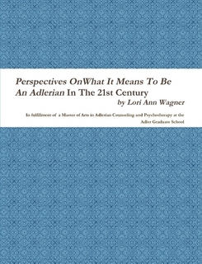
21st Century Adlerians
A Reference
http://www.lulu.com

